Slide 1
Section 2.3 – Authentication Technologies

Slide 2
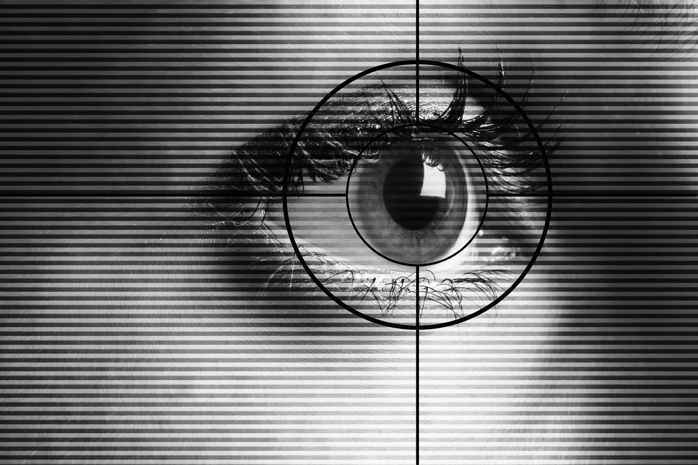
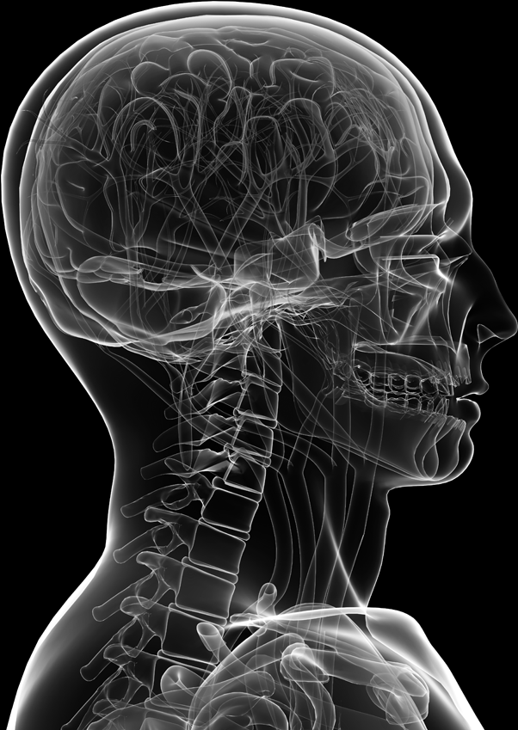
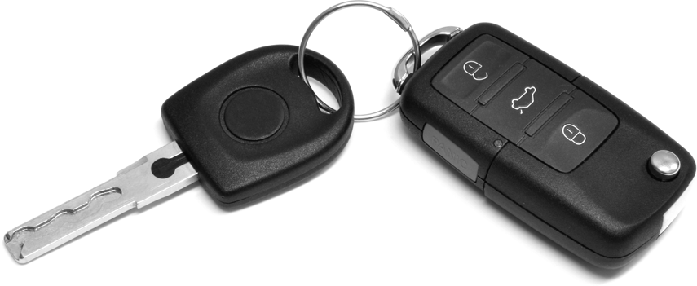
Authentication
The determination of identity, usually based on a combination of
something the person has (like a smart card or a radio key fob storing secret keys),
something the person knows (like a password),
something the person is (like a human with a fingerprint).
password=ucIb()w1V
mother=Jones
pet=Caesar
human with fingers
and eyes
Something you are
Something you know
radio token with
secret keys
Something you have

Slide 3
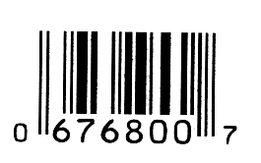
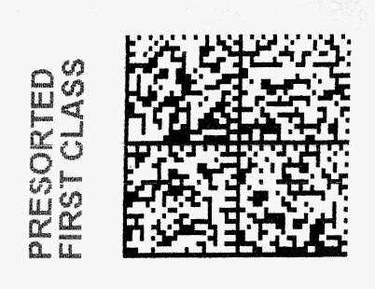
Barcodes
Developed in the 20th century to improve efficiency in grocery checkout.
First-generation barcodes represent data as a series of variable-width, vertical lines of ink, which is essentially a one-dimensional encoding scheme.
Some more recent barcodes are rendered as two-dimensional patterns using dots, squares, or other symbols that can be read by specialized optical scanners, which translate a specific type of barcode into its encoded information.

Slide 4
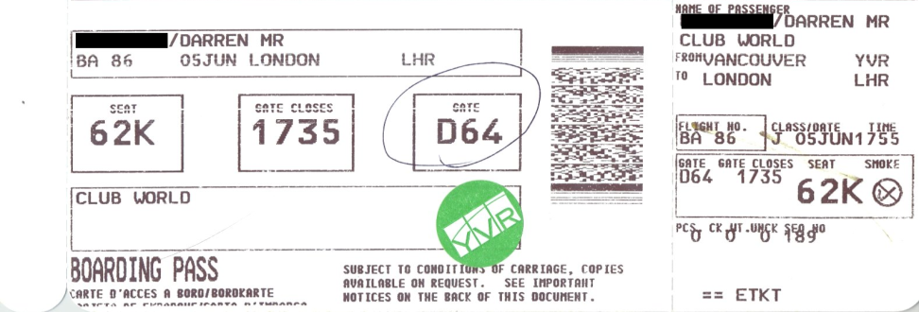
Authentication via Barcodes
Since 2005, the airline industry has been incorporating two-dimensional barcodes into boarding passes, which are created at flight check-in and scanned before boarding.
In most cases, the barcode is encoded with an internal unique identifier that allows airport security to look up the corresponding passenger’s record with that airline.
Staff then verifies that the boarding pass was in fact purchased in that person’s name (using the airline’s database), and that the person can provide photo identification.
In most other applications, however, barcodes provide convenience but not security. Since barcodes are simply images, they are extremely easy to duplicate.
Two-dimensional
barcode
Public domain image from http://commons.wikimedia.org/wiki/File:Bpass.jpg

Slide 5
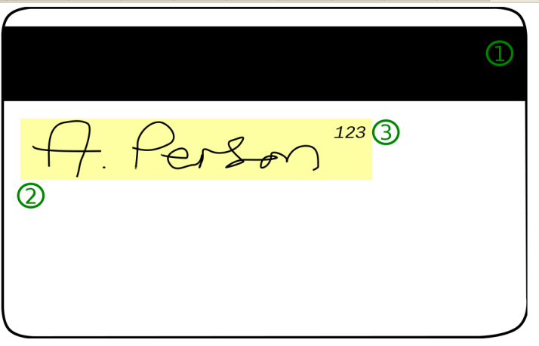
Magnetic Stripe Cards
Plastic card with a magnetic stripe containing personalized information about the card holder.
The first track of a magnetic stripe card contains the cardholder’s full name in addition to an account number, format information, and other data.
The second track may contain the account number, expiration date, information about the issuing bank, data specifying the exact format of the track, and other discretionary data.
Public domain image by Alexander Jones from http://commons.wikimedia.org/wiki/File:CCardBack.svg

Slide 6
Magnetic Stripe Card Security
One vulnerability of the magnetic stripe medium is that it is easy to read and reproduce.
Magnetic stripe readers can be purchased at relatively low cost, allowing attackers to read information off cards.
When coupled with a magnetic stripe writer, which is only a little more expensive, an attacker can easily clone existing cards.
So, many uses require card holders to enter a PIN to use their cards (e.g., as in ATM and debit cards in the U.S.).
Public domain image by Alexander Jones from http://commons.wikimedia.org/wiki/File:CCardBack.svg

Slide 7
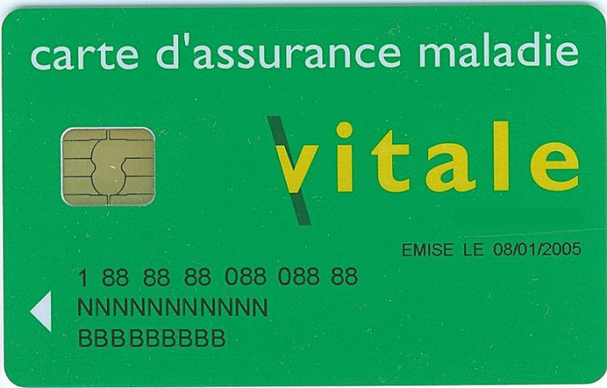
Smart Cards
Smart cards incorporate an integrated circuit, optionally with an on-board microprocessor, which microprocessor features reading and writing capabilities, allowing the data on the card to be both accessed and altered.
Smart card technology can provide secure authentication mechanisms that protect the information of the owner and are extremely difficult to duplicate.
Circuit interface
Public domain image from http://en.wikipedia.org/wiki/File:Carte_vitale_anonyme.jpg

Slide 8
Smart Card Authentication
They are commonly employed by large companies and organizations as a means of strong authentication using cryptography.
Smart cards may also be used as a sort of “electronic wallet,” containing funds that can be used for a variety of services, including parking fees, public transport, and other small retail transactions.

Slide 9
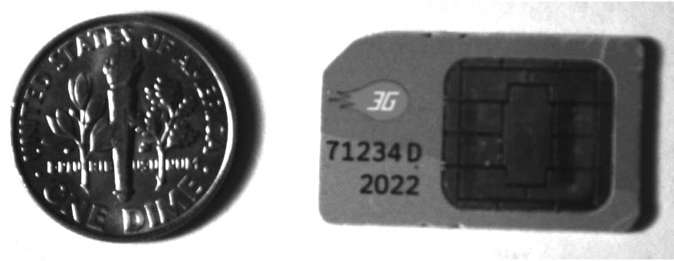
SIM Cards
Many mobile phones use a special smart card called a subscriber identity module card (SIM card).
A SIM card is issued by a network provider. It maintains personal and contact information for a user and allows the user to authenticate to the cellular network of the provider.

Slide 10
SIM Card Security
SIM cards contain several pieces of information that are used to identify the owner and authenticate to the appropriate cell network.
Each SIM card corresponds to a record in the database of subscribers maintained by the network provider.
A SIM card features an integrated circuit card ID (ICCID),
which is a unique 18-digit number used for hardware identification.
Next, a SIM card contains a unique international mobile subscriber identity (IMSI), which identifies the owner’s country, network, and personal identity.
SIM cards also contain a 128-bit secret key. This key is used for authenticating a phone to a mobile network.
As an additional security mechanism, many SIM cards require a PIN before allowing any access to information on the card.
GSM = Global System for Mobile Communications

Slide 11
GSM Challenge-Response Protocol
When a cellphone wishes to join a cellular network it connects to a local base station owned by the network provider and transmits its IMSI.
If the IMSI matches a subscriber’s record in the network provider’s database, the base station transmits a 128-bit random number to the cellphone.
This random number is then encoded by the cellphone with the subscriber’s secret key stored in the SIM card using a proprietary encryption algorithm known as A3, resulting in a ciphertext that is sent back to the base station.
The base station then performs the same computation, using its stored value for the subscriber’s secret key. If the two ciphertexts match, the cellphone is authenticated to the network and is allowed to make and receive calls.
IMSI = (this phone’s ID)
R = a 128-bit random number (the challenge)
E_{K}(R) = the 128-bit random number encrypted
using the subscriber’s secret key K
(the response)

Slide 12
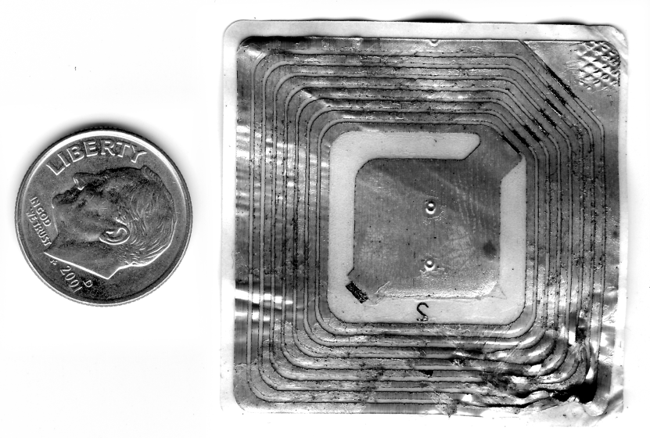
RFIDs
Radio frequency identification, or RFID, is a rapidly emerging technology that relies on small transponders to transmit identification information via radio waves.
RFID chips feature an integrated circuit for storing information, and a coiled antenna to transmit and receive a radio signal.

Slide 13
RFID Technology
RFID tags must be used in conjunction with a separate reader or writer.
While some RFID tags require a battery, many are passive and do not.
The effective range of RFID varies from a few centimeters to several meters, but in most cases, since data is transmitted via radio waves, it is not necessary for a tag to be in the line of sight of the reader.

Slide 14
RFID Technology
This technology is being deployed in a wide variety of applications.
Many vendors are incorporating RFID for consumer-product tracking.
Car key fobs.
Electronic toll transponders.
Locating animals and showing ownership.

Slide 15
Passports
Modern passports of several countries, including the United States, feature an embedded RFID chip that contains information about the owner, including a digital facial photograph that allows airport officials to compare the passport’s owner to the person who is carrying the passport.
RFID chip and
antenna is embedded
in the cover
e-Passport
symbol

Slide 16
Passport Security
In order to protect the sensitive information on a passport, all RFID communications are encrypted with a secret key.
In many instances, however, this secret key is merely the passport number, the holder’s date of birth, and the expiration date, in that order.
All of this information is printed on the card, either in text or using a barcode or other optical storage method.
While this secret key is intended to be only accessible to those with physical access to the passport, an attacker with information on the owner, including when their passport was issued, may be able to easily reconstruct this key, especially since passport numbers are typically issued sequentially.

Slide 17
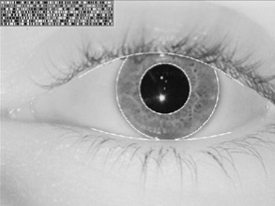
Biometrics

Slide 18
Something You Are
Biometric
“You are your key” --- Schneier
Examples
Fingerprint
Handwritten signature
Facial recognition
Speech recognition
Gait (walking) recognition
“Digital doggie” (odor recognition)
Many more!
Are
Know
Have

Slide 19
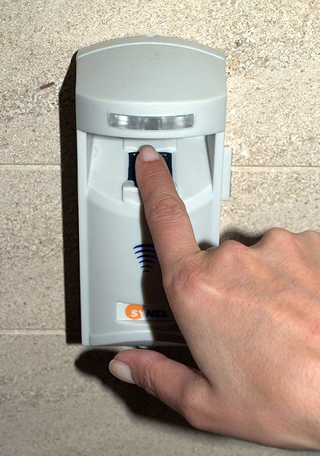
Biometrics
Biometric refers to any measure used to uniquely identify a person based on biological or physiological traits.
Generally, biometric systems incorporate some sort of sensor or scanner to read in biometric information and then compare this information to stored templates of accepted users before granting access.
Image from http://commons.wikimedia.org/wiki/File:Fingerprint_scanner_in_Tel_Aviv.jpg used with permission under the Creative Commons Attribution 3.0 Unported license

Slide 20
Requirements for Biometric Identification
Universality. Almost every person should have this characteristic.
Distinctiveness. Each person should have noticeable differences in the characteristic.
Permanence. The characteristic should not change significantly over time.
Collectability. The characteristic should have the ability to be effectively determined and quantified.
Easy and cheap to deploy.

Slide 21
Biometric Identification
Reader
Biometric
Feature vector
Comparison algorithm
Reference vector
matches
doesn’t match

Slide 22
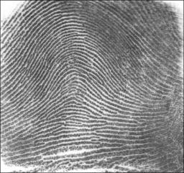
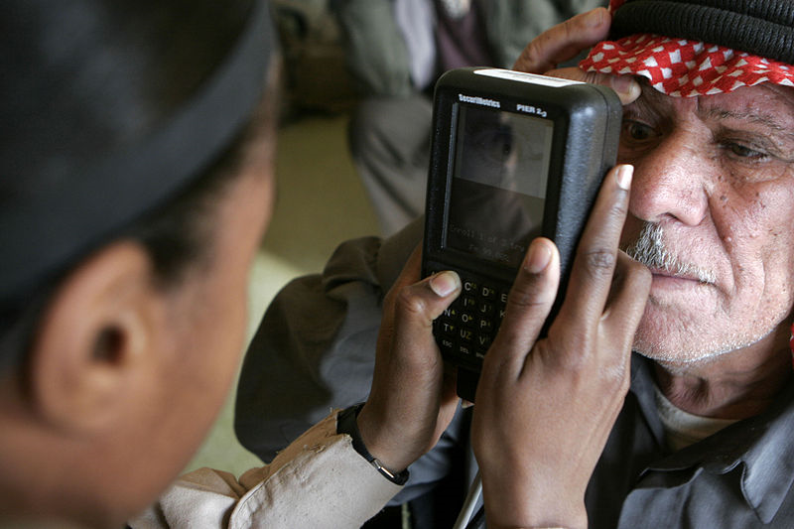
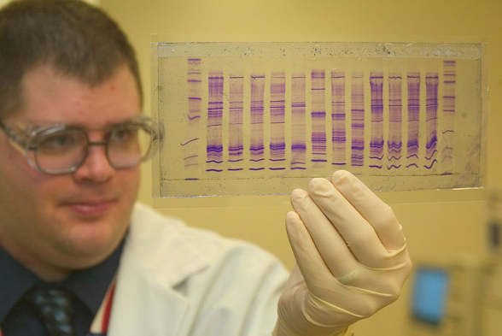
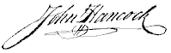
Candidates for Biometric IDs
Fingerprints
Retinal/iris scans
DNA
“Blue-ink” signature
Voice recognition
Face recognition
Gait recognition
Let us consider how each of these scores in terms of universality, distinctiveness, permanence, and collectability…
Public domain image from
http://commons.wikimedia.org/wiki/File:Fingerprint_Arch.jpg
Public domain image from
http://commons.wikimedia.org/wiki/File:Retinal_scan_securimetrics.jpg
Public domain image from
http://commons.wikimedia.org/wiki/File:CBP_chemist_reads_a_DNA_profile.jpg

Slide 23
Examples vs Ideal
Universality
Fingerprints are (almost)
Birthmarks and scars are not.
Distinctiveness
Retinal images and DNA are
Fingerprints almost always are
Existing of tonsils is not
Permanence is possessed by
DNA
Fingerprints (almost)
Collectability - depends

Slide 24
Why Biometrics?
Biometrics are seen by professionals as a desirable replacement for passwords
Cheap and reliable biometrics are still needed
Today, it is a very active area of research
Biometrics are used somewhat in security today
Thumbprint mouse
Palm print for secure entry
Fingerprint to unlock car door
Fingerprint to unlock laptop
But biometrics generally not used
Has not lived up to its promise (yet?)

Slide 25
Biometric Modes
Identification --- Who goes there?
Compare one to many
Example: The FBI fingerprint database
Authentication --- Is that really you?
Compare one to only one
Example: Thumbprint mouse
Identification problem more difficult
More “random matches” since more comparisons
We are interested in authentication as identification is another issue

Slide 26
Enrollment vs Recognition
Enrollment phase
Subject’s biometric info put into database
Must carefully measure the required info
OK if slow and repeated measurement needed
Must be very precise for good recognition
A weak point of many biometric schemes
Recognition phase
The biometric detection used in practice
Must be quick and simple
But must still be accurate

Slide 27
Cooperative Subjects
We are assuming cooperative subjects
In identification problem often have uncooperative subjects
For example, facial recognition
Proposed for use in Las Vegas casinos to detect known cheats
Also as way to detect terrorists in airports, etc.
Probably do not have ideal enrollment conditions
Subject will try to confuse recognition
Cooperative subject makes is much easier!

Slide 28
Biometric Errors
Fraud rate vs insult rate
Fraud --- user A (mis)authenticates as user B
Insult --- user A not authenticate as user A
For any biometric, can decrease fraud or insult, but other will increase
For example
99% voiceprint match ⇒ low fraud, high insult
30% voiceprint match ⇒ high fraud, low insult
Equal error rate: rate where fraud == insult
The best measure for comparing biometrics

Slide 29
Modern History Fingerprints
1823 -- Professor Johannes Evangelist Purkinje discussed 9 fingerprint patterns
1856 -- Sir William Hershel used fingerprint (in India) on contracts
1880 -- Dr. Henry Faulds article in Nature about fingerprints for ID
1883 -- Mark Twain in Life on the Mississippi a murderer ID’ed by fingerprint

Slide 30
Modern History Fingerprints
1888 -- Sir Francis Galton (cousin of Darwin) developed classification system
His system of “minutia” is still in use today
Also verified that fingerprints do not change
Some countries require a number of points (i.e., minutia) to match in criminal cases
In Britian, 15 points
In US, no fixed number of points required

Slide 31
Passwords
Passwords are widely-used for user authentication
Advantages:
Easy to use, understood by most users
Require no special equipment
Offer an adequate degree of security in many environments
Disadvantages:
Users tend to choose passwords that are easy to guess
Many password-cracking tools are available that are excellent at cracking passwords
There are many available on the internet.

Slide 32
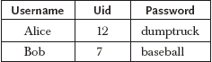
Originally - Using Passwords
User enters username and password
The operating system consults its table of passwords:
Match = user is assigned the corresponding uid
Problem: the table of passwords must be protected

Slide 33
Why Passwords?
Why is “something you know” more popular than “something you have” and “something you are”?
Cost --- passwords are free
Convenience --- easier to reset password than to issue new smartcard

Slide 34
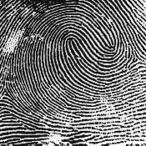
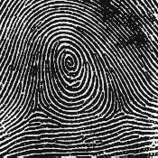
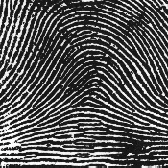
Fingerprints Comparison
Examples of loops, whorls and arches
Minutia extracted from these features
Loop (double)
Whorl
Arch

Slide 35
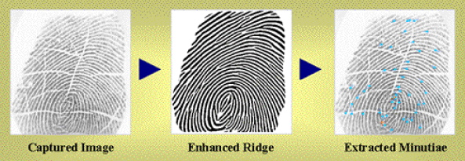
Fingerprint Biometric
Image of fingerprint captured
Image enhanced
The minutia are identified

Slide 36
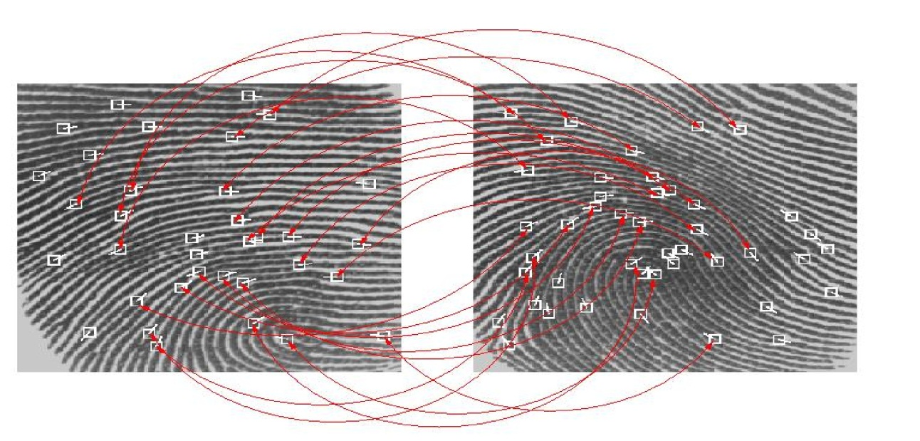
Fingerprint Biometric
Extracted minutia are compared with the supposed user’s minutia stored in database
Look for a statistical match

Slide 37
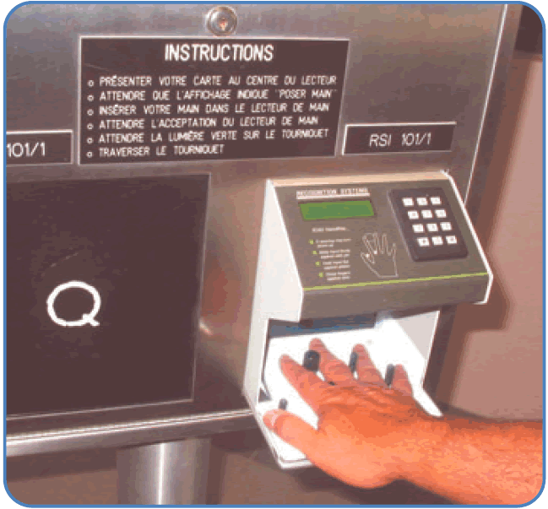
Hand Geometry
Popular form of biometric
Measures shape of hand
Width of hand, fingers
Length of fingers, etc.
Human hand not unique
Hand geometry sufficient for many situations
Suitable for authentication
Not useful for ID problem

Slide 38
Hand Geometry
Advantages
Quick
5 seconds for recognition
1 minute for enrollment
Hands symmetric (use other hand backwards)
Disadvantages
Cannot use on young or old
Relatively high equal error rate

Slide 39
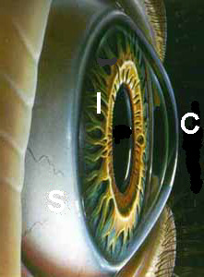
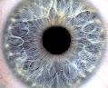
Iris Patterns
Iris pattern development is “chaotic”
Little or no genetic influence
Different even for identical twins
Pattern is stable through lifetime

Slide 40
Iris Recognition: History
1936 --- suggested by Frank Burch
1980s --- James Bond films
1986 --- first patent appeared
1994 --- John Daugman patented current best approach
Patent owned by Iridian Technologies

Slide 41
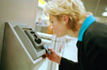
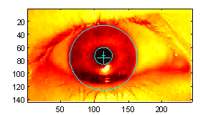
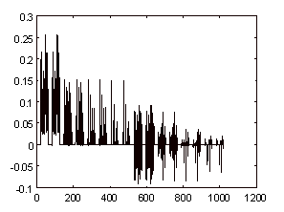
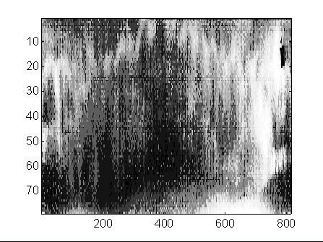
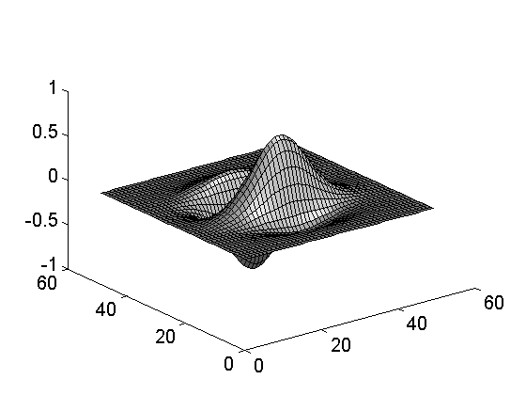
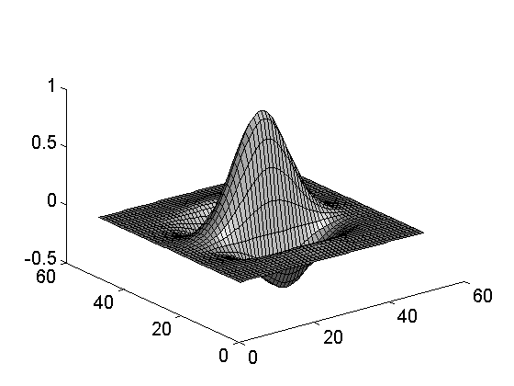
Iris Scan
Scanner locates iris
Take b/w photo
Use polar coordinates…
Find 2-D wavelet trans
Get 256 byte iris code

Slide 42
Measuring Iris Similarity
Based on Hamming distance
Define d(x,y) to be
# of non match bits/# of bits compared
d(0010,0101) = 3/4 and d(101111,101001) = 1/3
Compute d(x,y) on 2048-bit iris code
Perfect match is d(x,y) = 0
For same iris, expected distance is 0.08
At random, expect distance of 0.50
Accept as match if distance less than 0.32

Slide 43
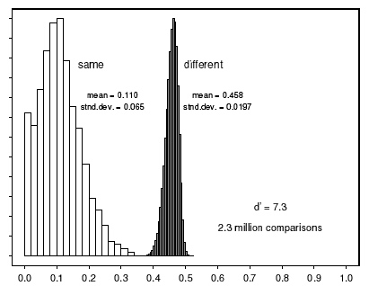

Iris Scan Error Rate
distance
Fraud rate
0.29 | 1 in 1.3∗10¹⁰
0.30 | 1 in 1.5∗10⁹
0.31 | 1 in 1.8∗10⁸
0.32 | 1 in 2.6∗10⁷
0.33 | 1 in 4.0∗10⁶
0.34 | 1 in 6.9∗10⁵
0.35 | 1 in 1.3∗10⁵
: equal error rate
distance

Slide 44
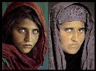
Attack on Iris Scan
Good photo of eye can be scanned
Then attacker can use photo of an eye
Afghan woman was authenticated by iris scan of old photo
To prevent attack, scanner could use light to be sure it is a “live” iris

Slide 45
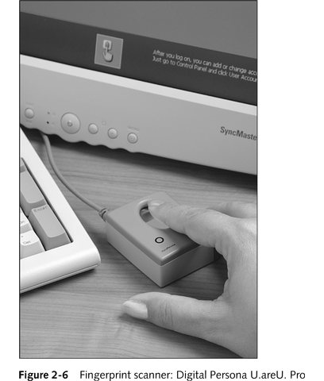
Fingerprint Biometrics
Ref for pictures 2-4 to 2-10: Security+ Guide to Network Security Fundamentals, Course Technology

Slide 46
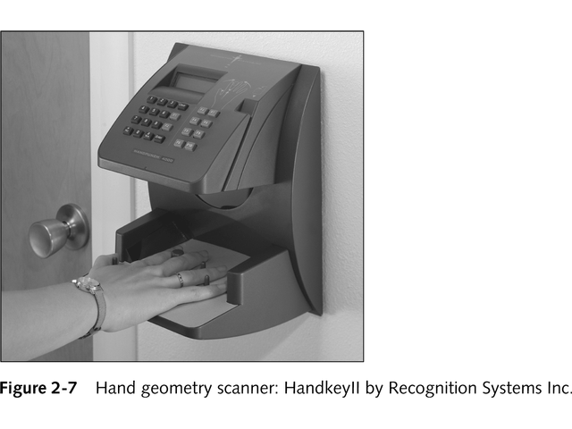
Hand Geometry Authentication

Slide 47
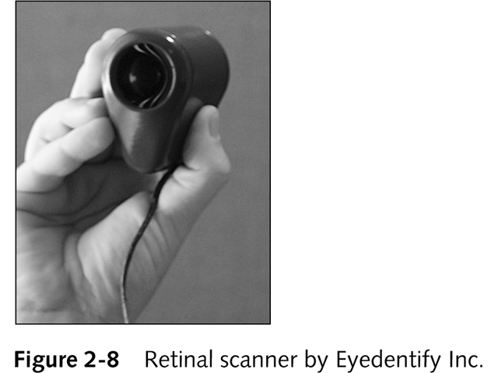
Retinal Scanning

Slide 48
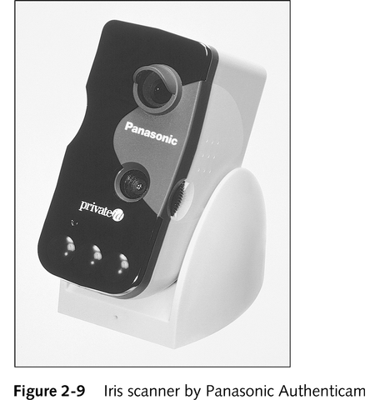
Iris Scanning

Slide 49
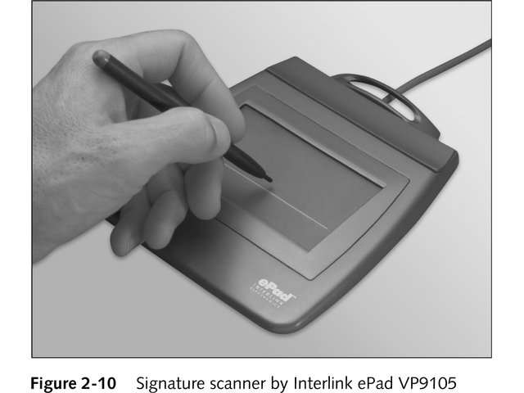
Signature Verification

Slide 50
Equal Error Rate Comparison
Equal error rate (EER): rate for fraud == insult
Fingerprint biometric has EER of about 5%
Hand geometry has EER of about 10⁻³
In theory, iris scan has EER of about 10⁻⁶
But in practice, hard to achieve
Enrollment phase must be extremely accurate
Most biometrics much worse than fingerprint!
ID biometrics are almost useless today

Slide 51
Biometrics: The Bottom Line
Biometrics are hard to forge
But attacker could
Steal Alice’s thumb
Photocopy Bob’s fingerprint, eye, etc.
Subvert software and/or database and/or “trusted path”
Also, how to revoke a “broken” biometric?
Biometrics are not foolproof!
Biometric use is limited today
That should change in the future…

Slide 52
Something You Have

Slide 53
Something You Have
Something in your possession
Many examples including
Car key
Laptop computer
Or specific MAC address
Password generator
We’ll look at this next
ATM card, smartcard, etc.

Slide 54
Something You Have
Something in your possession
Many examples including
Car key
Laptop computer
Or specific MAC address
Password generator
We’ll look at this next
ATM card, smartcard, etc.

Slide 55
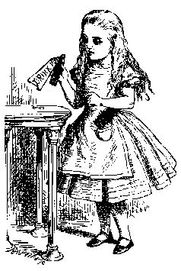

Password Generator – a Challenge-Handshake Method
“I’m Alice”
PIN, R
R
F(R)
F(R)
Password
generator
Bob
Alice
Alice gets “challenge” R from Bob
Alice enters R into password generator
Alice sends “response” back to Bob
Bob is convinced Alice has pwd generator

Slide 56
Password Generators are One-Time Passwords
Used only once for limited period of time; then is no longer valid
Uses shared keys and challenge-and-response systems, which do not require that the secret be transmitted or revealed
Strategies for generating one-time passwords
Counter-based tokens
Clock-based tokens

Slide 57
Single Sign-on
A hassle to enter password(s) repeatedly
Users want to authenticate only once
“Credentials” stay with user wherever the user goes
Subsequent authentication is transparent to user
Single sign-on for the Internet?
Microsoft: Passport
Everybody else: Liberty Alliance
Security Assertion Markup Language (SAML)

Slide 58
Cookies
Cookie is provided by a Website and stored on user’s machine
Cookie indexes a database at Website
Cookies maintain state across sessions
Web uses a stateless protocol: HTTP
Cookies also maintain state within a session
Like a single sign-on
Though a very weak form of authentication
Cookies and privacy concerns

Slide 59
Digital Signature
Digital signatures
Encrypted messages independently verified by a central facility (registry) as authentic
Digital certificate
Electronic document attached to a file certifying that the file is from the organization it claims to be from and has not been modified from the original format
Certificate authority (CA)
Agency that manages the issuance of certificates
Serves as the electronic notary public to verify certificate origin and integrity
Notes:
Digital Signatures
When the asymmetric process is reversed—the private key encrypts a (usually short) message, and the public key decrypts it—the fact that the message was sent by the organization that owns the private key cannot be refuted.
This nonrepudiation is the foundation of digital signatures.
Digital signatures are encrypted messages that are independently verified by a central facility (registry) as authentic.
A digital certificate is an electronic document, similar to a digital signature, attached to a file certifying that the file is from the organization it claims to be from and has not been modified from the original format.
A certificate authority (CA) is an agency that manages the issuance of certificates and serves as the electronic notary public to verify their origin and integrity.

Slide 60
How Much Trust Should One Place in a CA?
Reputable CAs have several levels of authentication that they issue based on the amount of data collected from applicants
Example: VeriSign

Slide 61
Certificate-Based Authentication
Can use digital certificates to authenticate users
Organization sets up a Public Key Infrastructure (PKI) that generates keys to users
User receives a code (public key) that is generated using the server’s private key and uses the public key to send encrypted information to the server
Server receives the public key and can decrypt the information using its private key
We will consider this more after we discuss encrypting schemes.

Slide 62
Security Tokens
Authentication devices assigned to specific user
Small, credit card-sized physical devices
Incorporated into two-factor authentication methods discussed shortly
Utilize base keys that are much stronger than short, simple passwords a person can remember

Slide 63
Cards or Tokens
This authentication mechanism makes use of something (a card, key, or token) that user or system possesses
One example is a dumb card (such as an ATM cards) with magnetic stripes
Another example is the smart card containing a processor
Another device often used is the cryptographic token, a processor in a card that has a display
Tokens may be either synchronous or asynchronous
Notes:
Something You Have
This authentication mechanism makes use of something (a card, key, or token) that the user or the system has.
While there are many implementations of this mechanism, one example is a dumb card, a category that includes ID and ATM cards with magnetic strips containing the digital (and often encrypted) PIN against which user input is compared.
A more capable object is the smart card, which contains a computer chip that can verify and validate other information in addition to PINs.
Another device often used is the cryptographic token, a computer chip in a card that has a display.
Tokens may be either synchronous or asynchronous.
Once synchronous tokens are synchronized with a server, each device (server and token) uses the time to generate the authentication number that is entered during the user login. Asynchronous tokens use a challenge–response system, in which the server challenges the user with a number.

Slide 64
Types of Security Tokens
Passive
Act as a storage device for the base key
Do not emit, or otherwise share, base tokens
Active
Actively create another form of a base key or encrypted form of a base key that is not subject to attack by sniffing and replay
Can provide variable outputs in various circumstances

Slide 65
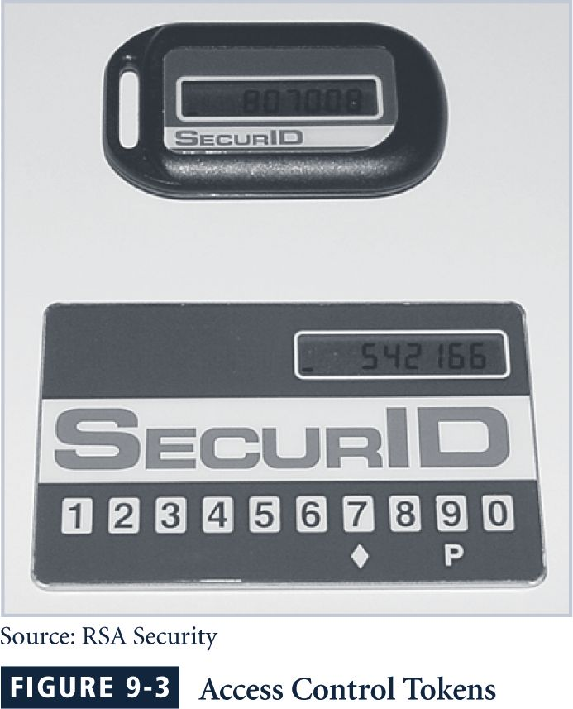
Access Control Tokens

Slide 66
Why Use Only One Strategy?

Slide 67
2-factor Authentication
Requires 2 out of 3 of
Something you know
Something you have
Something you are
Examples
ATM: Card and PIN
Credit card: Card and signature
Password generator: Device and PIN
Smartcard with password/PIN
Multi-factor authentication is being strongly proposed for purchases made by cell phones.

Slide 68
Disadvantages of 2-factor Authentication
Users don’t like to authenticate twice.
Do you deny all that fail at one, but not the other? – can cause dissatisfaction
Are 2 authentications really more secure?

Slide 69
Some Linux Specific Authentication Strategies

Slide 70
Managing Linux Passwords
Linux includes several facilities for managing passwords and enabling security measures
When a new user account is added to the system, a single line is added to the /etc/password file, but the actual encrypted password is stored in /etc/shadow
The shadow password file controls the username, the encrypted password data, last password change date, password expiration date, account expiration date, and more

Slide 71
Managing Linux Passwords
A user can change their password using the passwd utility
When this command is entered, the user is prompted to enter their current password, then their new password two times
passwd will perform a few basic checks on the entered password, but it can’t prevent the use of poor passwords
The shadow password system is used by default on all major Linux distributions

Slide 72
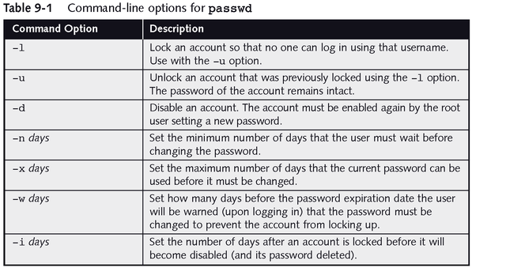
Managing Linux Passwords

Slide 73
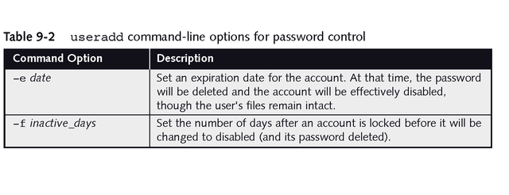
Managing Linux Passwords

Slide 74
Using Pluggable Authentication Modules
The Pluggable Authentication Module (PAM) architecture was developed by Sun and is now used on virtually every Linux distribution
PAM provides improved user-level security, flexibility in managing user authentication and smoother Linux to non-Linux data integration
To use PAM, select the modules necessary to to control the activity of a program, and list them in the program’s configuration file

Slide 75
Using Pluggable Authentication Modules
PAM is configured using either a single file, etc/pam.conf, or a series of files in /etc/pam.d
PAM supports four module types:
auth modules are used for identifying a user, normally by prompting for a password
account modules typically restrict account access
session modules tend to tasks required before user’s can work, such as creating a log file
password modules are executed when a user needs to change a password

Slide 76
Using Pluggable Authentication Modules
The control_flag element determines how PAM processes stacked modules, and ultimately to permit or deny access:
required means all modules are executed and if one fails, access is denied
requisite means that if a module fails, remaining modules are not executed, and access is denied
sufficient means that the final result can be access permitted, even if this module fails
optional means that the result of the module does not affect the final result of the stack

Slide 77
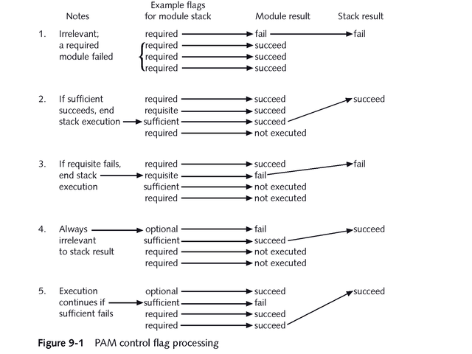
Using Pluggable Authentication Modules

Slide 78
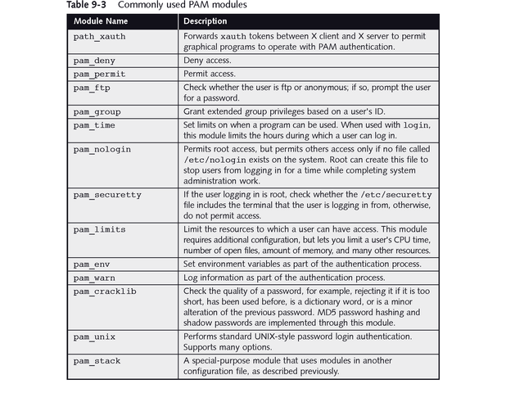
Using Pluggable Authentication Modules

Slide 79
Security Tools for Users
There are many security utilities and related files that system administrators and users need to be aware of, some PAM controlled
Screen locking programs disable keyboard input and hide the screen so that private information is not visible nor accessible
vlock is used from a text console to lock the current screen, or all of the virtual consoles
xlock is similar to vlock, only it is employed from a graphical interface, and is a feature of X Windows

Slide 80
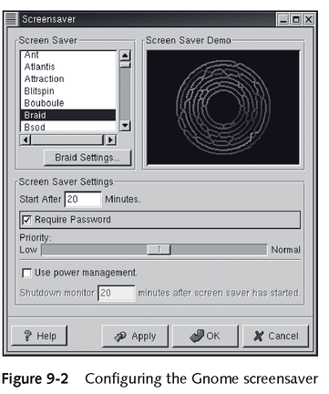
Security Tools for Users

Slide 81
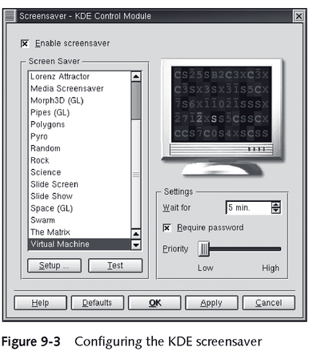
Security Tools for Users

Slide 82
Security Files and Utilities
Linux provides several methods for safeguarding or controlling the login process:
The root user can only log in from terminals that are listed in the file /etc/securetty
If the /etc/nologin file exists, only root can log in at that time and when this file is deleted, all users can log in again
Executable files can have a special file permission set (the Set UID bit, or SUID) that causes them to take on the permissions of the user who owns the file rather than the user who executed the file

Slide 83
Security Files and Utilities
More Linux-provided security methods:
The Linux file systems support a number of attributes that can be set on any file
The PAM module pam_time can be used with the login program to limit when a user can log in
If the standard bash shell for Linux is running, an environment variable can be set which will log a user out after a certain number of idle seconds
In the tsch shell, an environment variable accomplishes the same thing, but in a matter of minutes, not seconds

Slide 84
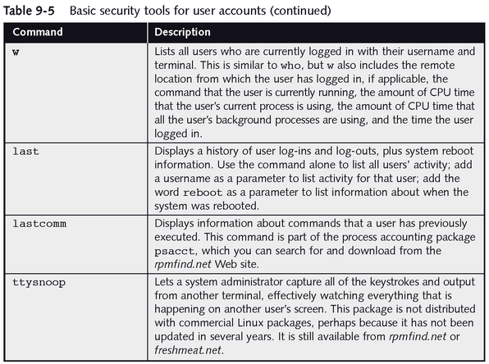
Seeing Who Is Using Linux

Slide 85
Good and Bad Passwords
Bad passwords
frank
Fido
password
4444
Pikachu
102560
AustinStamp
Good Passwords?
jfIej,43j-EmmL+y
09864376537263
P0kem0N
FSa7Yago
0nceuP0nAt1m8
PokeGCTall150

Slide 86
Selecting Strong Passwords
Passwords must not be written down, especially not anywhere near the computer to which they provide access
Passwords must be chosen carefully so they can be remembered without a written aid
Passwords should not include easily guessed words or numbers
Users should be taught to never to tell anyone their password

Slide 87
Selecting Strong Passwords
Ideas for creating good passwords:
A minimum of eight characters should be sufficient
It should include at least one number or symbol
It could be one or more words separated by one or more symbols or numbers
Multiple words works better if they are foreign or altered so that they do not appear in a dictionary
Using a series of numbers or a pattern of altered letters can make it easier to remember your password

Slide 88
Selecting Strong Passwords
Using strong passwords reduces the possibility of a cracker utilizing social engineering to gain access to your system
Crackers can resort to brute force attacks where all possible combinations are tried until one succeeds in guessing a password
Some system administrators use password cracking tools to randomly test the strength of user’s passwords

Slide 89
Password Experiment
A passphrase is a plain-language phrase, typically longer than a password, from which a virtual password is derived
Example: Alice loves Bob and Bob loves Trudy!
AlBaBlT!
Three groups of users --- each group advised to select passwords as follows
Group A: At least 6 chars, 1 non-letter
Group B: Password based on passphrase
Group C: 8 random characters
Results
Group A: About 30% of pwds easy to crack
Group B: About 10% cracked
Passwords easy to remember
Group C: About 10% cracked
Passwords hard to remember
winner →

Slide 90
Password Experiment
A passphrase is a plain-language phrase, typically longer than a password, from which a virtual password is derived
Example: Alice loves Bob and Bob loves Trudy!
AlBaBlT!
Three groups of users --- each group advised to select passwords as follows
Group A: At least 6 chars, 1 non-letter
Group B: Password based on passphrase
Group C: 8 random characters
Results
Group A: About 30% of pwds easy to crack
Group B: About 10% cracked
Passwords easy to remember
Group C: About 10% cracked
Passwords hard to remember
winner →

Slide 91
Password Experiment
User compliance hard to achieve
In each case, 1/3rd did not comply (and about 1/3rd of those easy to crack!)
Assigned passwords sometimes best
If passwords not assigned, best advice is
Choose passwords based on passphrase
Use pwd cracking tool to test for weak pwds
Require periodic password changes?

Slide 92
Attacks on Passwords
Attacker could…
Target one particular account
Target any account on system
Target any account on any system
Attempt denial of service (DoS) attack
Common attack path
Outsider → normal user → administrator
May only require one weak password!

Slide 93
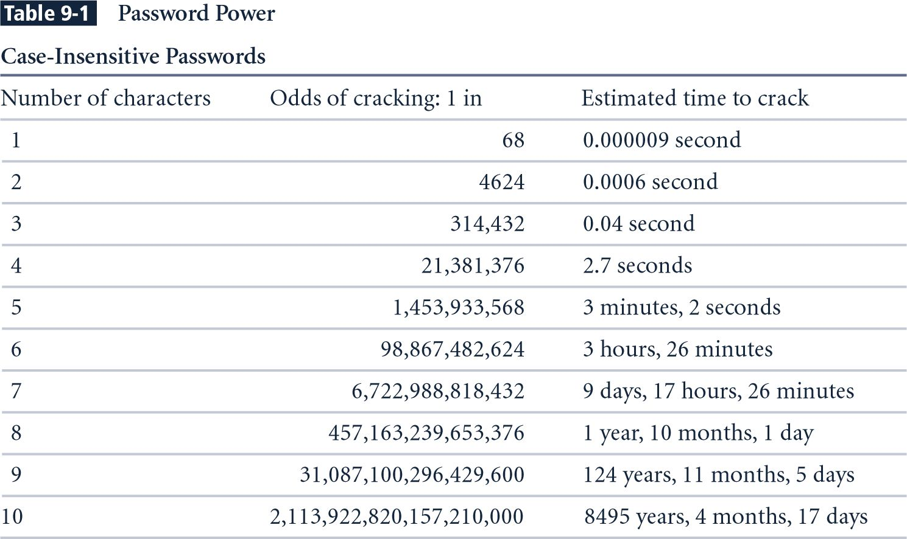
Brute Force Tries-Pentium 4 performing 8 million guesses per second
Notes:
Estimated Time to Crack is based on a Pentium 4 computer performing 8 million guesses per second. The estimates take into consideration all keyboard characters, some of which are not allowed by some systems.

Slide 94
Password Retry
Suppose system locks after 3 bad passwords. How long should it lock?
5 seconds
5 minutes
Until SA restores service
What are +’s and -’s of each?

Slide 95
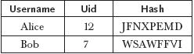
Using Passwords and One-Way Functions
User’s password is not stored in the table
A one-way hash* of the password, h(password), is stored in the table
h(dumptruck) = JFNXPEMD
h(baseball) = WSAWFFVI
* hash is just a fancy word for a function or method that has few collisions and cannot be reversed. – i.e. no inverse function exists.

Slide 96
Using Passwords and One-Way Functions (cont)
User enters username and password
The operating system hashes the password
The operating system compares the result to the entry in the table
Match = user is assigned the corresponding uid
Advantage: password table does not have to be protected
Disadvantage: dictionary attacks do work

Slide 97
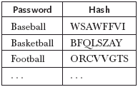
A Dictionary Attack
An attacker can compile a dictionary of several thousand common words and compute the hash for each one:
Look for matches between the dictionary and the password table
Example: WSAWFFVI tells us Bob’s password is baseball

Slide 98
Dictionary Attacks (cont)
Dictionary attacks are a serious problem:
Costs an intruder very little to send tens of thousands of common words through the one-way function and check for matches
Between 20 and 40 percent of the passwords on a typical system can be cracked in this way
Solution #1: don’t allow users to select their own passwords
System generates a random password for each user
Drawback:
Many people find system-assigned passwords hard to remember and therefore they write them down
Example: L8f#n!.5rH’
You can find huge numbers of post-it notes on screens, under keyboards, and in top drawers of desks that contain passwords!

Slide 99
Combating Dictionary Attacks
Solution #2: password checking
Allow users to choose their own passwords
Do not allow them to use passwords that are in a common dictionary
Solution #3: salt the password table
A salt is a random string that is concatenated with a password before sending it through the one-way hash function
Random salt value chosen by system
Example: plre
Password chosen by user
Example: baseball

Slide 100

Salting the Password Table
Password table contains:
Salt value = plre
h(password+salt) = h(baseballplre) = FSXMXFNB

Slide 101
Salting the Password Table (cont)
User enters username and password
The operating system combines the password and the salt and hashes the result
The operating system compares the result to the entry in the table
Match = user is assigned the corresponding uid
Advantages:
Password table does not have to be protected
Dictionary attacks are much harder

Slide 102
A Dictionary Attack
Attacker must now expand the dictionary to contain every possible salt with each possible password:
baseballaaaa
baseballaaab
baseballaaac
….
baseballaaaz
baseballaaba
baseballaabb
….
26⁴ (about half a million) times more work to check each word in the dictionary (for 4-letter salts)
And, how do they know a 4-letter salt is being used?

Slide 103
Password Cracking – Some More Probabilities
Assumptions:
Pwds are 8 chars, 128 choices per character
Then 128⁸ = 2⁵⁶ possible passwords
There is a password file with 2¹⁰ pwds
Attacker has dictionary of 2²⁰ common pwds
Probability of 1/4 that a pwd is in dictionary

Slide 104
Password Cracking
Attack 1 password without dictionary
Must try 2⁵⁶/2 = 2⁵⁵ on average
Just like exhaustive key search
Attack 1 password with dictionary
Work is measured by number of hashes
Expected work is about
1/4 (2¹⁹) + 3/4 (2⁵⁵) = 2^{54.6}
But in practice, try all in dictionary and quit if not found --- work is at most 2²⁰ and probability of success is 1/4

Slide 105
Password Cracking
Attack any of 1024 passwords in file
Without dictionary
Assume all 2¹⁰ passwords are distinct
Need 2⁵⁵ comparisons before expect to find password
If no salt, each hash computation gives 2¹⁰ comparisons ⇒ the expected work (number of hashes) is 2⁵⁵/2¹⁰ = 2⁴⁵
If salt is used, expected work is 2⁵⁵ since each comparison requires a new hash computation
Notes:
Picture would be useful here

Slide 106
Password Cracking
Attack any of 1024 passwords in file
With dictionary
Probability at least one password is in dictionary is 1 - (3/4)¹⁰²⁴ = 1
We ignore case where no pwd is in dictionary
If no salt, work is about 2¹⁹/2¹⁰ = 2⁹
If salt, expected work is less than 2²²
Note: If no salt, we can precompute all dictionary hashes and amortize the work
Notes:
Calculation for salted case:
Number the passwords in file, pwd1, pwd2, …,pwd1024
Consider checking each pwd in turn. The probability pwd1 is in the dictionary is 1/4 and, if so, expected work (no. of hashes) is 2^19. If pwd1 is not in dictionary but pwd2 is, we do 2^20 hashes (for pwd1) plus an expected 2^19 hashes for pwd2. The probability of this is (3/4)(1/4). Continuing, we find the expected work factor is
(1/4)*(2^19) + (3/4)*(1/4)*(2^20+2^19) + (3/4)^2*(1/4)*(2*2^20+2^19)+…+ + (3/4)^1023*(1/4)(1023*2^20+2^19) < 2^22

Slide 107
Other Password Issues
Too many passwords to remember
Results in password reuse
Why is this a problem?
Who suffers from bad password?
Login password vs ATM PIN
Failure to change default passwords
Social engineering
Error logs may contain “almost” passwords
Bugs, keystroke logging, spyware, etc.

Slide 108
Packet Sniffers
Packet sniffer
Network tool that collects and analyzes packets on a network
Can be used to eavesdrop on network traffic
Must be connected directly to a local network from an internal location
Passwords are often sent in plaintext!
To use a packet sniffer legally, you must:
Be on a network that the organization owns, not leases
Be under the direct authorization of the network’s owners
Have the knowledge and consent of users
Have a justifiable business reason for doing so
More about these later.
Notes:
Packet Sniffers
A packet sniffer is a network tool that collects and analyzes copies of packets from the network.
In the wrong hands, it can be used to eavesdrop on network traffic.
To use a packet sniffer most effectively, you must be connected directly to a local network from an internal location.
To use a packet sniffer legally, you must:
(1) be on a network that the organization owns, not leases;
(2) be under the direct authorization of the network’s owners;
(3) have the knowledge and consent of the users; and
(4) have a justifiable business reason for doing so.

Slide 109
Passwords
The bottom line
Password cracking is too easy!
One weak password may break security
Users choose bad passwords
Social engineering attacks, etc.
The bad guy has all of the advantages
All of the math favors bad guys
Passwords are a big security problem

Slide 110
Passwords
The bottom line
Password cracking is too easy!
One weak password may break security
Users choose bad passwords
Social engineering attacks, etc.
The bad hacker has all of the advantages
All of the math favors bad hackers
Passwords are a big security problem

Slide 111
Password Cracking Tools
Popular password cracking tools
Password Crackers
Password Portal
L0phtCrack and LC4 (Windows)
John the Ripper (Unix)
Admins should use these tools to test for weak passwords since attackers will!
Good article on password cracking
Passwords - Conerstone of Computer Security

